Slide 1


Bank Marketing
-Meghana H P

Slide 2

OBJECTIVE
The data is related with direct marketing campaigns (phone calls) of a Portuguese banking institution. The classification goal is to predict if the client will subscribe a term deposit.

Slide 3
FACTORS CONTRIBUTING
Age: Age of the customer
Job: Type of job (Management, technician, entrepreneur, blue-collar, retired, admin, services, self-employeed, unemployed, housemaid, student, unknown)
Education: education level (Tertiary, secondary, primary, unknown)
Default: has credit in default or not
Balance: average yearly balance
Housing: has housing loan or not
Loan: has personal loan or not
Contact: contact communication type (Cellular, telephone, unknown)

Slide 4
…FACTORS CONTRIBUTING
Day: last contact day of the week
Month: last contact month of the year
Duration: last contact duration in seconds
Campaign: number of contacts performed during this campaign and for this client
Pdays: number of days that passed by after the client was last contacted from a previous campaign
Previous: number of contacts performed before this campaign and for this client
Poutcome: outcome of the previous marketing campaign
Y: has the client subscribed a term deposit?

Slide 5
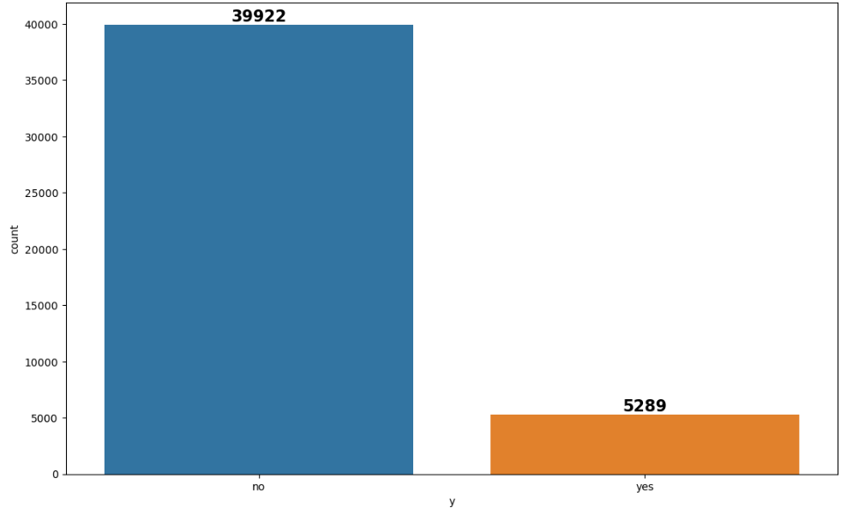
INSIGHTS 1) Outcome distribution
The graph says that most of the people DO NOT subscribe to the term deposit in the bank.

Slide 6
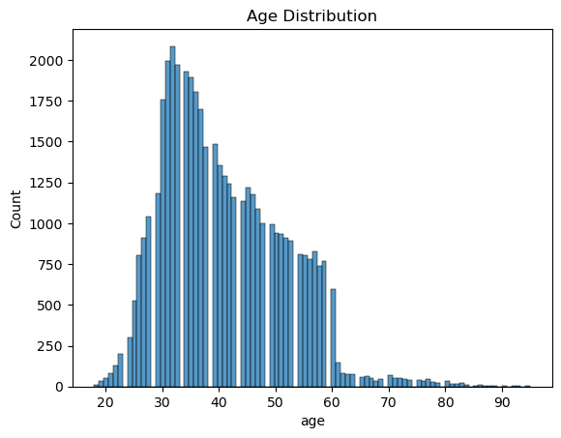
…INSIGHTS 2) Age distribution
Most of the customers belong to the age category between 30 to 40 years.

Slide 7
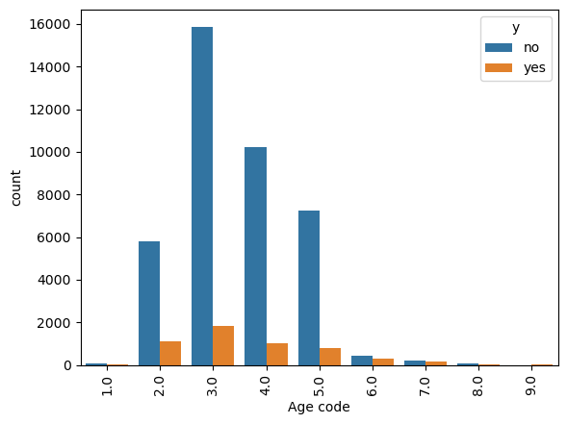
…INSIGHTS 3) Age group in terms of outcome
The bank will be in benefit if their target customers are of the age of 30-40 years. This is when a person starts to set up various assets.
Here, 1= 10-19 years
2= 20-29 years
… and so on

Slide 8
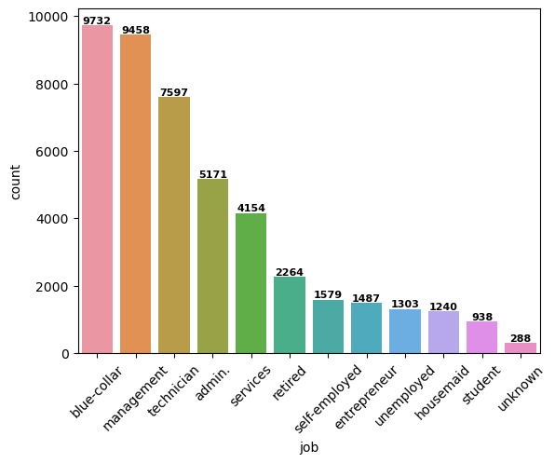
…INSIGHTS 4) Employment type
Majority of the consumer have blue-collar jobs and management posts, the next being technicians

Slide 9
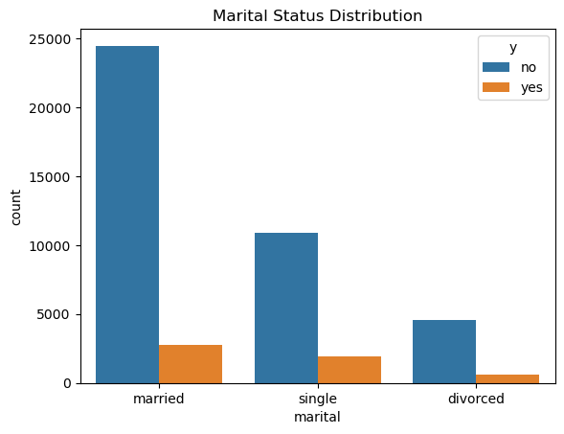
…INSIGHTS 5) Marital status
Married people are more likely to subscribe for a term deposit than the single and divorced ones

Slide 10
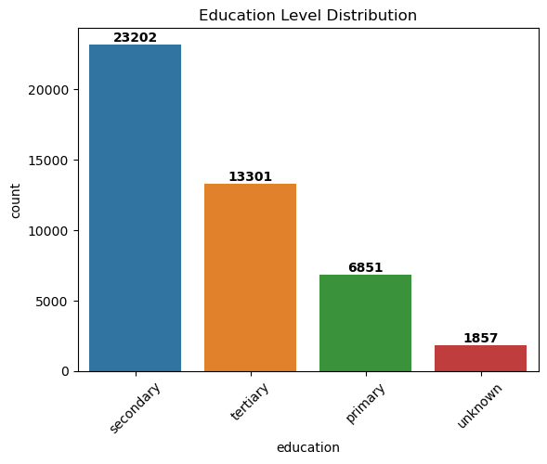
…INSIGHTS 6) Education level
Majority of the customers are having a secondary education. Very few have unknown education. Maybe not interested in revealing it or they have no educational background as such.

Slide 11
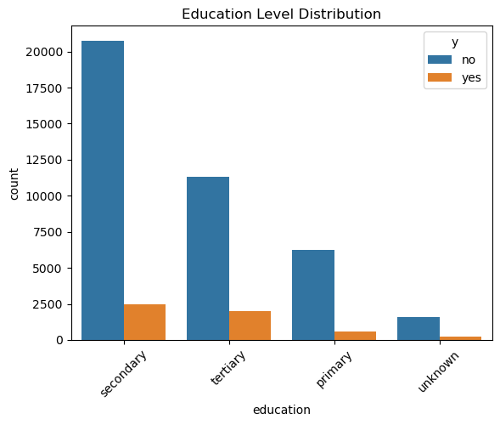
…INSIGHTS 7) Education in terms of outcome
The probability of subscription follows the education level.

Slide 12
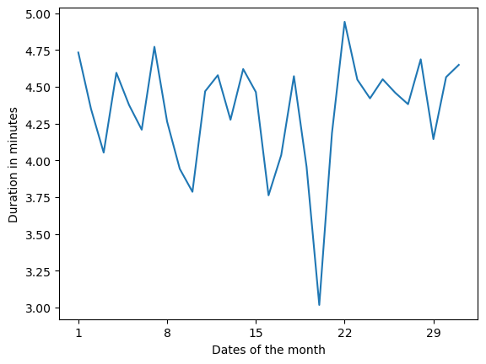
…INSIGHTS 8) Education in terms of outcome
There is no such pattern found in the duration of the calls during the month. However, there is a sudden dip around 20th of the month. Maybe the customers are very much busy during these times.

Slide 13
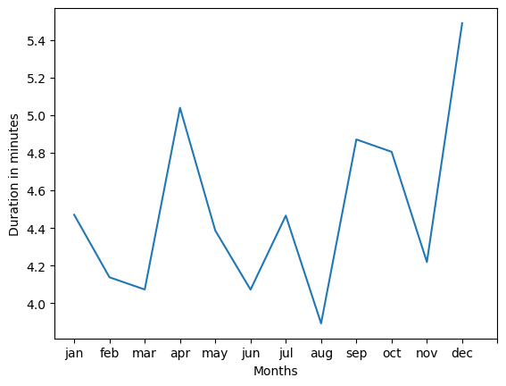
…INSIGHTS 9) Education in terms of outcome
There is an overall positive trend going on for the duration of the year. The maximum being in December
A sudden hike is observed during April. This maybe because it’s the beginning of the financial year and many might be interested in such schemes.

Slide 14
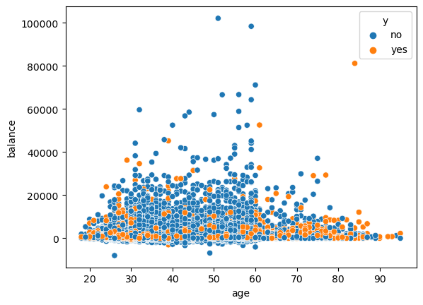
…INSIGHTS 10) Age v/s balance
It is seen from the scatter plot that majority of the people belonging to all the age group's balance is between 0 to 30,000. Among them, most of the people who subscribe to the term deposit's balance is around 10,000. This shows that the people only who are in need of money subscribe to the term deposits.

Slide 15
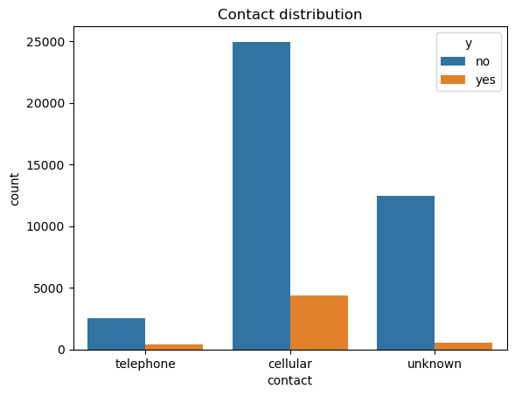
…INSIGHTS 11) Mode of contact
Cellular is the most popular type of contact and the chances of a customer subscribing to the term deposit is also more here.

Slide 16
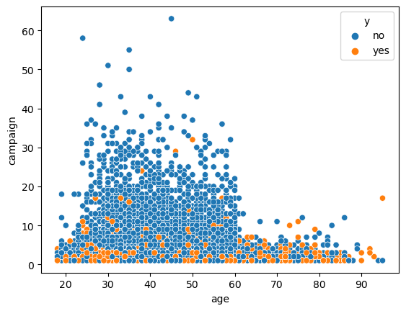
…INSIGHTS 12) Campaign calls
If the number of calls are more than 5, the probability of subscription is less. Thus the number of calls should be very effective with minimum number of calls.

Slide 17
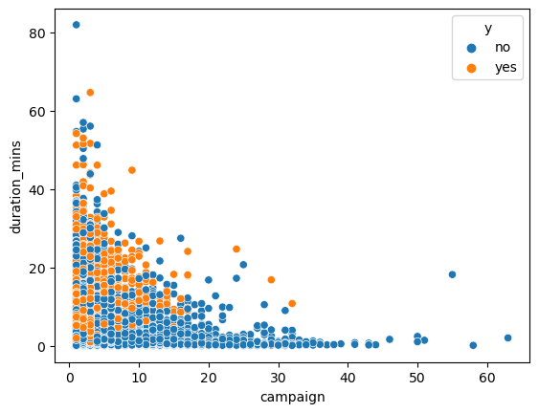
…INSIGHTS 13) Duration v/s number of calls
The duration is more if the number of campaign is as minimal as possible. It is in this region that the customer is most likely to subscribe.

Slide 18
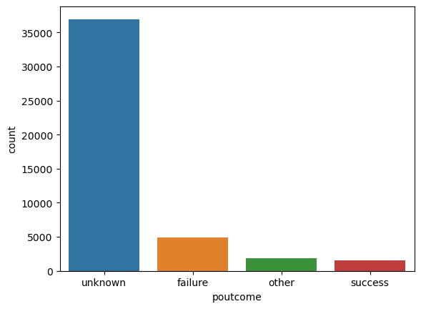
…INSIGHTS 14) Mode of contact
The success rate is very less during the previous campaign.

Slide 19
HOW TO INCREASE THE SUBSCRIPTIONS?
Target the customers of age between 30-40 years
Target the customers who are mostly married and give special offers to that of single and divorced in order to attract them
Target people with higher and tertiary education level
April and December is the peak time to attract more customers into subscribing
People with lower income tend to subscribe to the term deposit
Having a cellular mode of contact helps in getting more subscribers
Number of contacts should be minimum and effective.

Slide 20
MODELS AND THEIR PERFORMANCES
Model name | Train Accuracy | Test Accuracy
1) Logistic regression | 79% | 81%
2) Decision Tree classifier | 100% | 83%
3) Random Forest classifier | 100% | 86%
Among the three models, Random Forest Classifier is giving better accuracies with the results being more generalized.
Hence this model is further worked upon and fine tuned for better results.

Slide 21
FINAL RESULTS
The best model used for the predictions of this marketing campaign is Random Forest Classifier with an accuracy of 83% .
This means that whenever this model is deployed, the results are 86% of the time reliable, leaving just 14% of uncertainty.

Slide 22
TO SEE THE CODE FILE OF THIS PROJECT…
Please visit → https://github.com/MeghanaHPP/Bank-Marketing

Slide 23
“Marketing is a race without a finishing line”
- philip kotler

